Slide 1
Project 4
Mark and Ben

Slide 2
Goal
Communicate to 2 MSP430 slave devices via I2C from 1 master
Use keypad to lock and unlock system, and provide information sent
Display information sent on LED bar and LCD

Slide 3
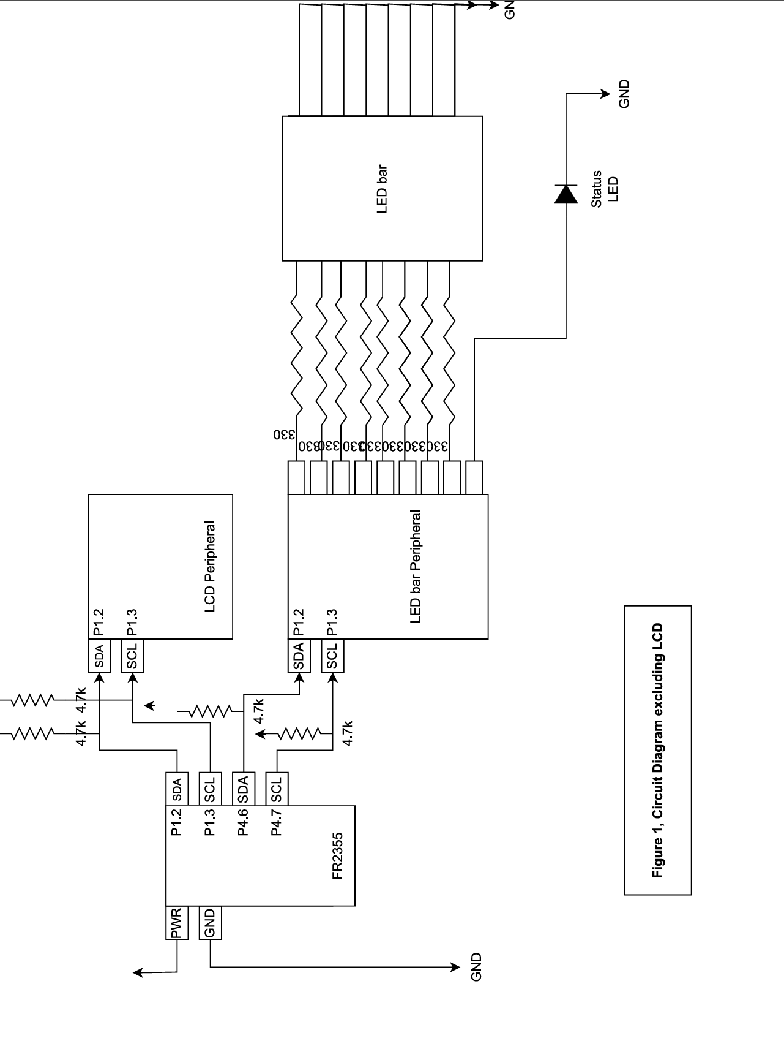
Circuit Diagram

Slide 4
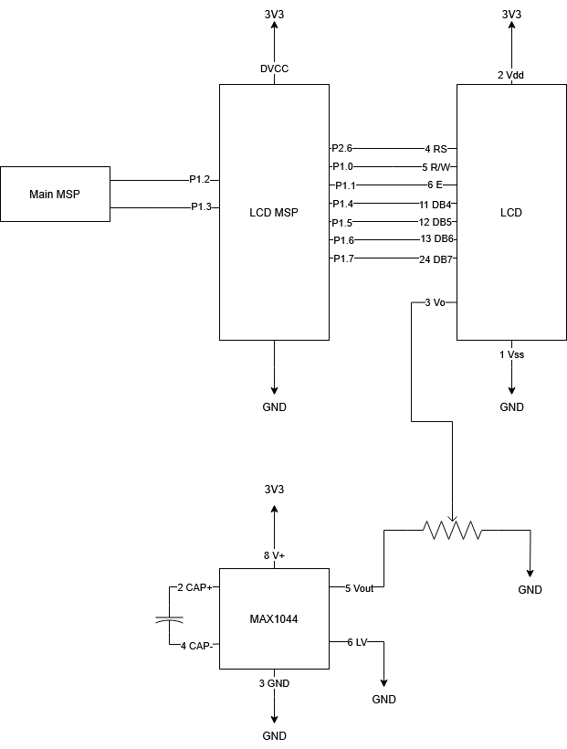
LCD Circuit Diagram

Slide 5
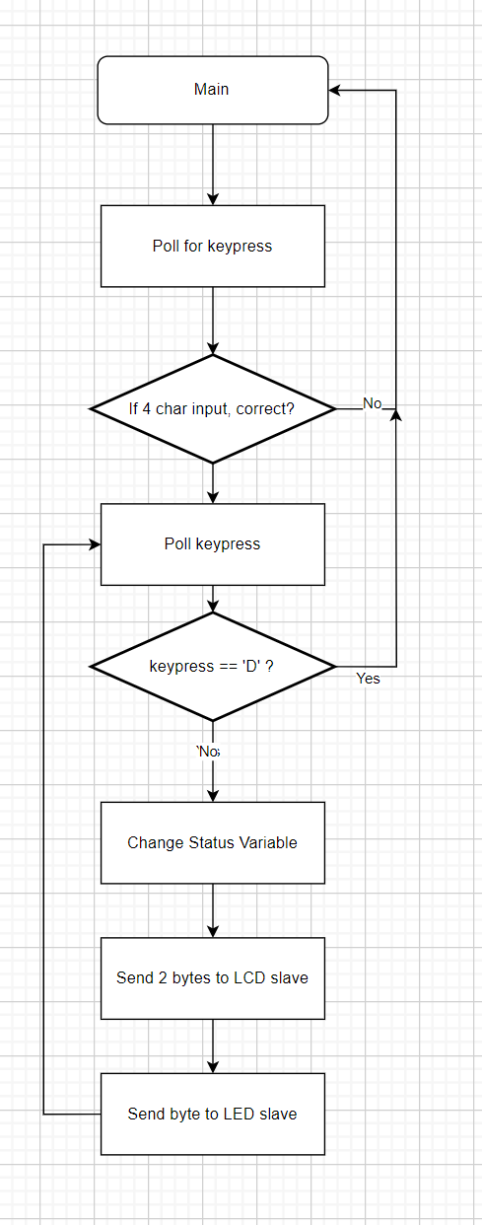
Controller Flowchart

Slide 6
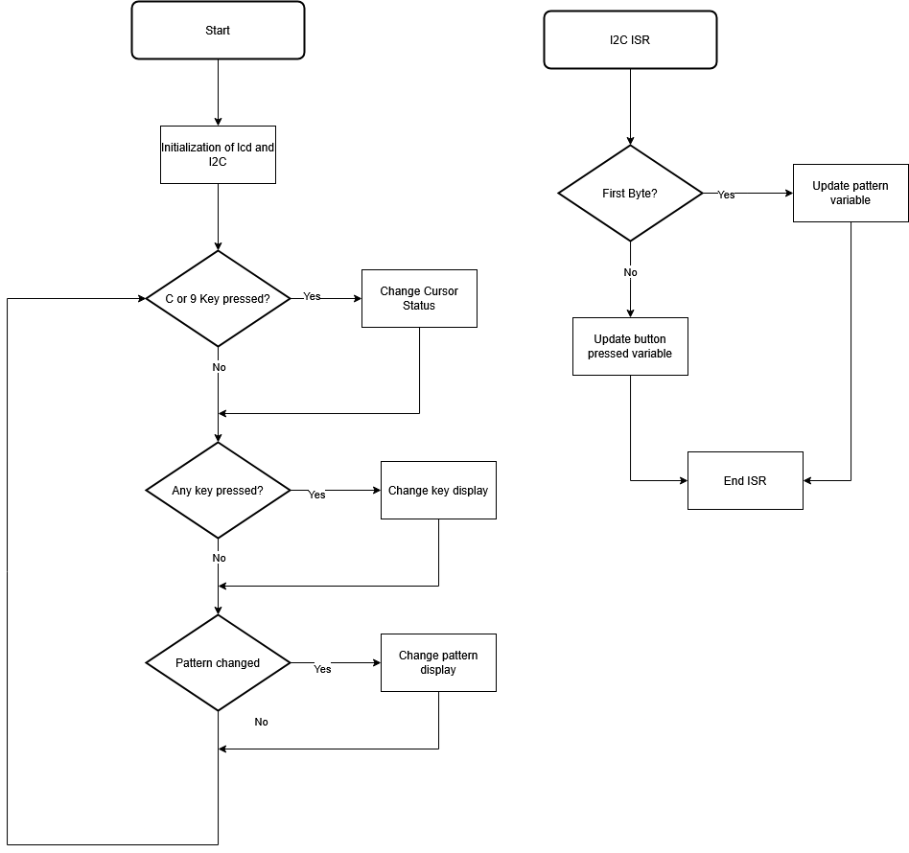
LCD Flowchart

Slide 7

Demo

